Slide 1
Site Orientation
Health Care Support Worker HCSW
Prepared by FHA HCAP team, October 2023
hcap@fraserhealth.ca

Slide 2
This presentation is created by the Fraser Health Authority’s Health Career Access Program team to support Long Term Care and Assisted Living employers with the on-boarding of their Health Care Support Workers.
Submit feedback to hcap@fraserhealth.ca

Slide 3
Learning Objectives
You will understand why the Health career access program was established
You will understand the Health Care Support Worker (HCSW) position and your obligations
You will know how to apply to a post secondary institution and understand that your schooling will be full time
You will understand what you can and cannot do as an HCSW and who will supervise you, as part of the care team
You will understand how you will be paid

Slide 4
Links to Orientation Courses
REMINDER:
“Provincial Standard Health Care Support Worker Orientation Program” is required to complete before you work as an HCSW
It is a 22.5 hour package of courses on Learning Hub to complete.
You will be paid for this time by submitting your certificate of completion to your site manager.
You can watch the “Getting Started Webinar” to see how to use learning HUB and create your account
Getting started Webinar QR code
Provincial Standard Health Care Support Worker Orientation Program QR code

Slide 5
Acronyms List / Terms
Here are some terms you need to understand:
HCAP – Health Career Access Program
HCSW – Health Care Support Worker
PSI – Post Secondary Institution (the school you will be attending)
LTC – Long Term Care
AL – Assisted Living
Resident – Accepted term for a person living and receiving care in this care community
CNE – Clinical Nurse Educator
RN – Registered Nurse
LPN –Licensed Practical Nurse
HCA – Health Care Aide also known as RCA – Registered Care Aide

Slide 6
Why was the Health Career Access Program started?
The COVID-19 pandemic increased the stress on long-term care and assisted living communities
To address this need the British Columbia government launched the Health Career Access Program to:
Hire Health Care Support Workers (HCSW), a new role that provides non-direct care that supports the residents and current staff
Supports participants to go to school to become health care assistants (HCA) to relieve the shortage of HCA’s in our province

Slide 7
Your health care support worker position and obligations
Your HCSW role is temporary, full time; while you work at our facility as an HCSW
12- 18 months and then followed by 12 month return of service
The Ministry of Health will cover the cost of your salary as a health care support worker (HCSW), for the cost of your schooling, and pay you an educational stipend to help cover living expenses while you are attending school.
In turn you must work for one year as a HCA at your site of hire into HCAP or you have to pay the government back for the cost of your schooling. This is called the Return of Service agreement

Slide 8
Here is how it works:
Work as a health care support worker (HCSW), 37.5 hour a week
You are matched with a school, complete your application successfully and go to school
Fulltime
You work as a HCSW during extended breaks
You graduate and become a registered health care assistant (HCA)
You apply for posted HCA positions
You are hired by our facility as a casual HCA at minimum; officially starting your 12 month
Return of Service
(ROS)
You complete your 12 month ROS !!
And continue to work with our team, supporting our residents

Slide 9
Health care support worker (HCSW) role
You are part of the care team
You will be supervised by a regulated staff member such as a registered nurse or licensed practical nurse
You may also receive direction from the care team member you are working with, for example, the HCA may ask you to make a patient’s bed.
You will be given a daily schedule, so you know what you are doing at what time.
On the next slide are some thing you can and can not do as a HCSW. Remember its ok to say I don’t think I can do that, and discuss the task with your supervisor if you are unsure

Slide 10
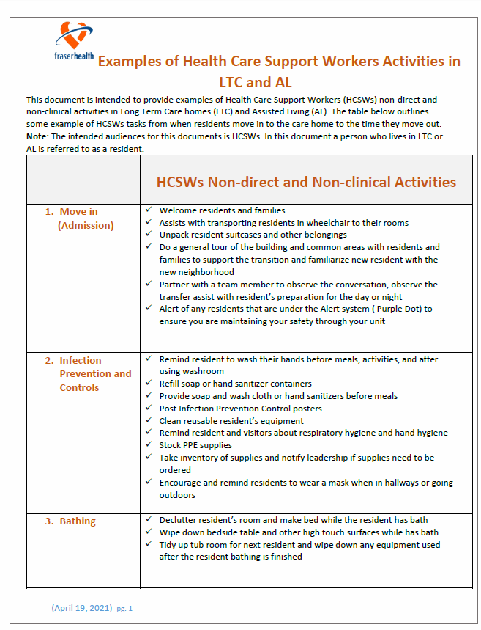
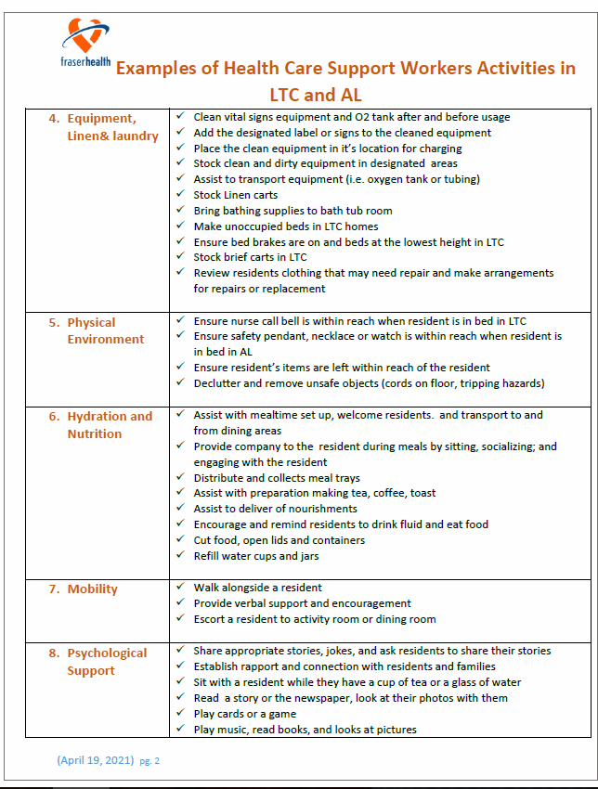
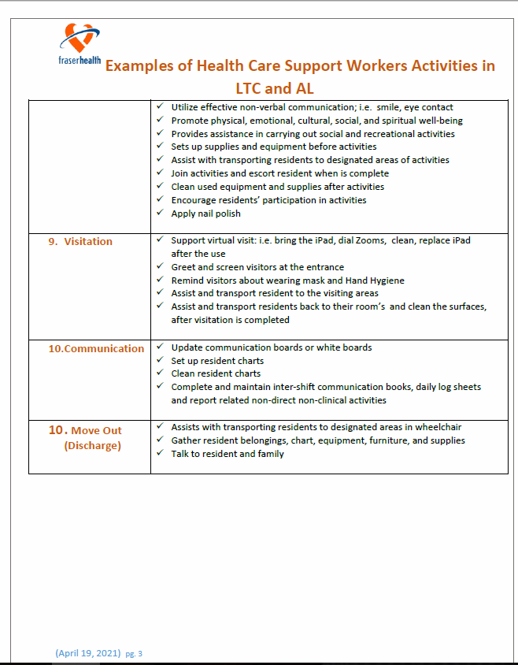
Health Care Support Worker activity examples

Slide 11
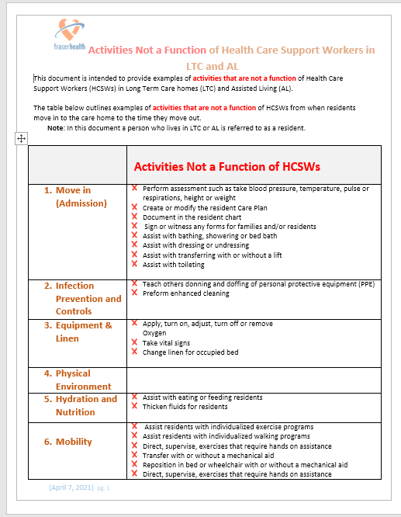
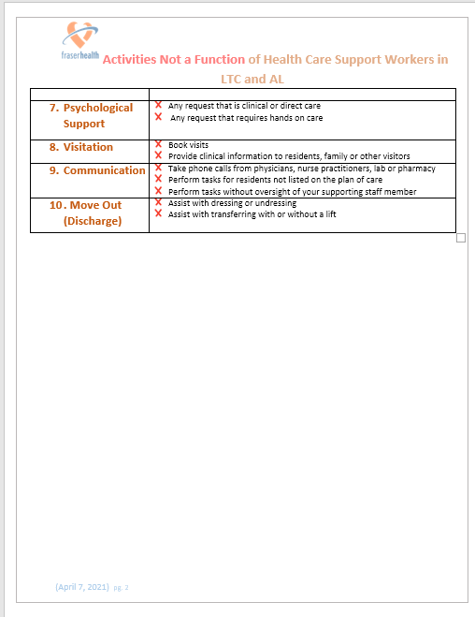
Activities NOT a function of Health Care Support Workers

Slide 12
You will improve the quality of life of residents
By spending one to one time with residents
By helping your team members, you free them up to have more time to provide clinical support to the residents

Slide 13
Information about your health care assistant (HCA) schooling
Fraser Health will assign you to the school you will attend
Fraser Health or the post secondary institute (PSI) will contact you to confirm when you apply to start school Follow the instructions from the school to submit your application and supporting documents.
You may work full-time as a health care support worker (HCSW) for several weeks or months before going to school
The training is fulltime. Ensure you provide your site with your school schedule as soon as you receive it from your school
You will work at the facility during extended breaks from school only
Although you will be learning new things when you are in school, you can not practice these things as a HCSW until you graduate and register as a HCA
There are many pre-requisites to complete for school, please ensure to connect with the HCAP team for support with this

Slide 14
Your Pay
You are paid hourly as a HCSW Health Care Support Worker
When you are in school you receive a weekly stipend, this is taxable income and will be paid as per usual through FHA payroll
If you are interested in when or if you are eligible for benefits please reach out to your site manager for your specific benefit eligibility.
HCAP employees can take 10 days off per year without pay, when working as HCSW’s. You need to apply for, and wait for approval, on all requested days off the same as all site employees. Please connect with site managers regarding specific time off you may have if you were an internal hire.

Slide 15
What questions do you have?
At anytime reach out to the Regional HCAP team at:
HCAP@fraserhealth.ca
for HCAP pathway Questions
Connect with your site manager regarding pay, scheduling, benefits; all standard employee questions
Your CNE can support you with orientation and onboarding questions.

Slide 16
hcap@fraserhealth.ca

