Slide 1

Tabletop exercise: Heat event
Long-term Care/Assisted Living (LTC/AL)
[date]

Slide 2
Agenda
Land acknowledgment
Overview
  Introduction
  Purpose
  Format
  Processes
Tabletop exercise
Closing

Slide 3
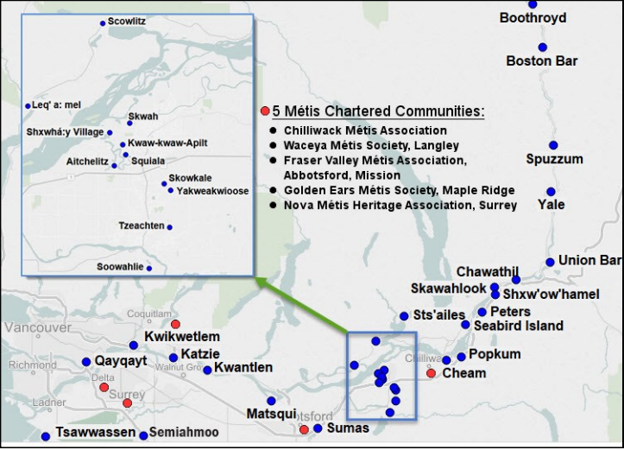
Land acknowledgement
We are meeting today on the traditional and unceded territory of the Coast Salish peoples, including the territories of the Katzie, Kwikwetlem, Kwantlen, Tsawwassen, and Semiahmoo Nations.
Source: www.johomaps.net
Notes:
This is mark

Slide 4
Introduction
A guided discussion using a scripted event to ensure preparedness of LTC/AL facilities to heat plans
Designed to promote free and open exchange of ideas and provide an opportunity to improve
This is a training event and we would like to remind everyone of the importance of maintaining a “no-fault” atmosphere
Notes:
Was: to access/evaluate
Was: to heat plans

Slide 5
Purpose
Simulate activation and escalation to a heat event
  Standard, escalated and emergency measures
Raise awareness of heat planning and resources
Practice site coordination to a simulated heat event

Slide 6
Format
Players
Site-based leadership
Key clinical and support staff
Medical staff
Scenarios
Cooling pattern
Resident safety impacts
Increasing temperatures
Heat warning

Slide 7
Process: Key triggers and actions
Level | Trigger
Standard actions | To be taken to prevent indoor temperatures from exceeding 26°C
Escalated actions | To be taken when temperatures approach or reach 26°C
Emergency actions | To be taken if the indoor temperature exceeds 26°C
Notes:
Focus attention on the fact that a response should be based on internal temperatures

Slide 8
Process: Escalation
Notes:
Focus on escalation and notification process, based on temperature readings and monitoring, and resident safety

Slide 9
Tabletop exercise
Respond to exercise events and information as if the emergency were real, unless otherwise directed by an exercise facilitator
Parts of the scenario may seem implausible; recognize that the exercise has objectives to satisfy and may require incorporation of unrealistic aspects
All external exercise communications will begin and end with the statement, “EXERCISE, EXERCISE, EXERCISE”
If the exercise needs to end (i.e. true emergency), use the terminology “NO DUFF” to indicate the exercise is over / attention is required to a real event
Next slide is the START of the exercise

Slide 10
Scenario 1: Increasing indoor temperatures
Monday, July 18 14:00
Indoor temperatures are increasing and it is anticipated that they might reach 26ºC

Slide 11
Scenario 1: Increasing indoor temperatures
Monday, July 18 14:00
Indoor temperatures are increasing and it is anticipated that they might reach 26ºC
Discussion
  How are you preparing for:
    Staffing
    Hydration and cooling
    Resident relocation
    Managing internal temperatures
    Operational changes (food, recreation, etc.)
  Identify any equipment and supply needs
  Who are we notifying?
  At what point do we begin to implement escalated or emergency measures?
Notes:
Potential answers:
How are we preparing for:
Implement standard actions
Cooling and hydration supplies are being checked
Communications to staff and families are being prepared and or sent-out
Planning for additional staff
Who are we notifying?
Staff, facility medical directors, residents, and families
Are we reaching out to the Health Authority?
Has the Health Authority reached out to us?

Slide 12
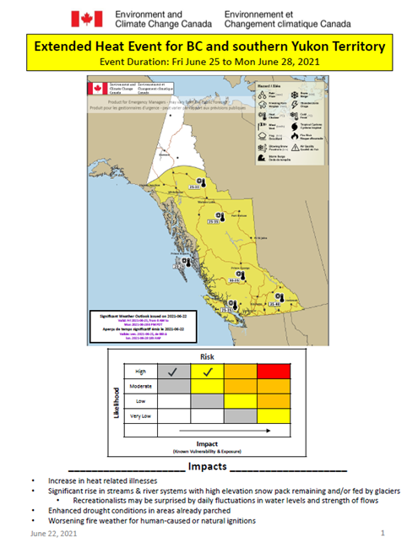
Scenario 2: Anticipated hot weather for the weekend
Thursday, July 21 09:00 (+4 days)
Indoor temperatures are approaching 26ºC and are anticipated to continue to rise throughout the weekend
Environment and Climate Change Canada issues a Heat Warning (2 or more consecutive days of daytime maximum temperatures are expected to reach 33°C or warmer and nighttime minimum temperatures are expected to be at 17°C or warmer)
  Fraser Health has forwarded the Heat Warning to all LTC/AL sites in the Fraser region
The LTC/AL program has scheduled a coordination call for all sites within the Fraser Health region

Slide 13
Scenario 2: Anticipated hot weather for the weekend
Thursday, July 21 09:00 (+4 days)
Indoor temperatures are approaching 26ºC and are anticipated to continue to rise throughout the weekend
Discussion
Describe key impacts you are monitoring for and the triggers for response escalation
How are you preparing (now through weekend):
    Staffing
    Hydration and cooling
    Resident relocation
    Managing internal temperatures
    Operational changes (food, recreation, etc.)
Who are you notifying?
Notes:
Possible answers
Describe key impacts you are monitoring for and the triggers for response escalation
Portable air conditioners deployed
A plan for increasing hydration of residents (e.g. adding additional staff to support active hydration)
Assessing residents for heat-related illness and dehydration using a standardized protocol
Ensuring fans are being used, particularly to bring air from cool spaces to warm spaces (note that fans should not be used when the indoor temperature is 36°C or higher, because beyond this temperature they cause heat to be transferred from the air to the body)
Ensuring windows remain closed in the morning and open in the evening, where this would not create a safety risk for residents
Ensuring curtains are drawn shut in the morning and drawn open at night
What are some things you will be reporting in the coordination call?
Preparedness level
Staffing levels
Cooling equipment status
Any concerns?
Any resident impacts

Slide 14
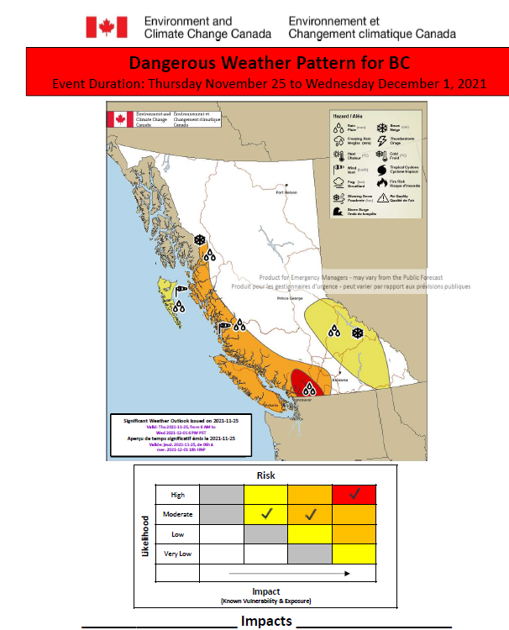
Scenario 3: Impacts from heat event
Friday, July 22 14:00 (+5 days)
Indoor temperatures have exceeded 26ºC
Heat related illnesses are being observed among residents
No longer meeting baseline staff requirements
Power failure (i.e. HVAC system down as emergency generator cannot support)

Slide 15
Scenario 3: Impacts from heat event
Friday, July 22 14:00 (+5 days)
Discussion
Describe key impacts you are monitoring and experiencing, and the triggers for response escalation
When should external partners be involved (health authority, other LTC/AL sites, contractors)?
How are you preparing for:
    Staffing concerns
    Hydration and cooling
    Resident relocation
    Managing internal temperatures
    Operational changes (food, recreation, etc.)
Identify any remaining staff and resident safety risk to escalate to the health authority, following the implementation of emergency measures (i.e. HVAC failure)
Notes:
Possible answers:
Describe key impacts you are monitoring for and the triggers for response escalation
Renting portable air conditioning units
Frequently assessing all residents for signs of heat-related illness or dehydration using standardized protocol
More frequent measurement of indoor temperature (at least twice daily)
Rotating residents into air-conditioned rooms
Encouraging residents to use self-dousing or ice towels, where this would not create a safety hazard
Adding additional staff to support increased active hydration, Taking residents to visit municipal or other local cool air shelters (e.g. public library, community centre)
Transferring residents out of the facility, starting with those most vulnerable to heat-related illness
Reaching out to Health Authority for support and guidance
When should external partners be involved (Health Authority, other LTC/AL sites, contractors)?

Slide 16
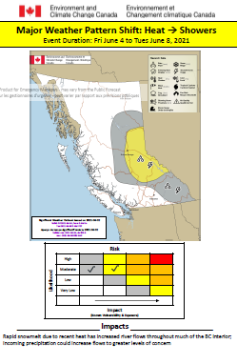
Scenario 4: Cooling pattern
Sunday, July 24 14:00 (+7 days)
Discussion
What is the trigger to stand down your response?
How will you incorporate any identified changes to your heat plan?
Where is your documentation being stored?
Is psychosocial support required?
When are your debriefs and after action reports scheduled?
Notes:
Consideration: Although the criteria for the heat warning may no longer be met; internal temperatures may still be rising and require emergency measures.

Slide 17

Debrief

Slide 18
Resources
ECAlertMe
https://ecalertme.weather.gc.ca/home_en.php
WeatherCAN app https://apps.apple.com/ca/app/weathercan/id1334221563
Alertable
https://alertable.ca/#/

