Slide 1
Ltc/al PROVIDERS COVID-19 Town hall
June 15, 2021
To Submit Questions:
Go TO /Click on link below and enter the code
https://www.sli.do/
Event Code #LTcAL

Slide 2
We conduct our business on the unceded and traditional shared territories of the Katzie, Semiahmoo, Kwantlen, Kwikwetlem and Tsawwassen First Nations.
Notes:
We conduct our business on the unceded and traditional shared territories of the
kate-zee | semi-ah-moo | kwant-len | kwee-kwet-lum | tsa-wah-sen

Slide 3
Agenda 2:15PM – 3:00PM
Welcome & Introductions – David Thompson | Advisor, Pandemic Planning
Finance Update – Harjit Gill | Executive Director, Financial Planning & Business Support
Highlights of the Revised Prevention Assessment – David Thompson | Advisor, Pandemic Planning & Susan Brown | Director Prevention & Response LTC/AL Coordination Centre
Rapid Point of Care Testing – Samantha Stevens | Manager, LTC Clinical Practice, Regional Residential Clinician
Questions via Sli.do

Slide 4
Finance update
June 15, 2021
Harjit Gill | Executive Director, Financial Planning & Business Support

Slide 5
Highlights of the revised prevention assessmenT
June 15, 2021
David Thompson | Advisor, Pandemic Planning
Susan Brown | Director, Prevention & Response LTC-AL Coordination Centre

Slide 6
PREVENTION ASSESSMENT review Update
Review process
Shared Work Team and Working Groups
Highlights
Next Steps

Slide 7
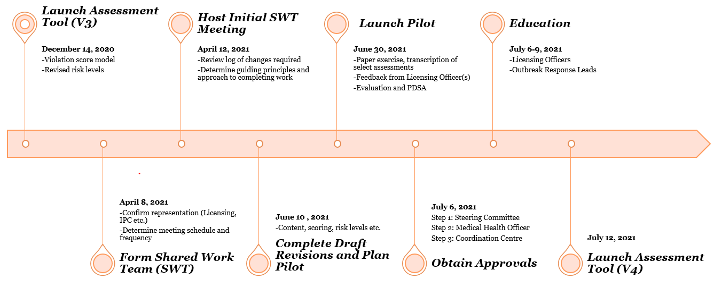
Review process
today

Slide 8
Shared work team and working groups
Program/Area | Representative
Co-Chairs | David Thompson & Susan Brown
Infection Prevention & Control | Petra Welsh, Elaine Demeule, Shelley Garcha Chris Wituik, Eva Habib, Iona Brierton-Joseph
Public Health | Diana Dickin, Jennifer Rice
Outbreak Response Lead | Jane Wark, Candace Larson
Licensing | Naomi Tanaka-Jesson, Kiran Dhaliwal
CNE Representative | Mike Mutter (LTC), Meryl Salon (AL)
LTC Provider Representative | Marina Young, DOC – Kinsmen Lodge Davinda Renke, Manager – Queen’s Park Care Centre
AL Provider Representative | Jackie Reiners, Executive Director – Augustine House Jenny Sapon, Site Manager – Residences at Belvedere
IL Provider Representative | Tanya Snow, Director – Bria Communities Amanda Khan Persaud, Manager – Amica
FAN Representative | Erroll Hastings, Executive Director – Zion Park Kathy Nduwayo, Park Place Seniors Living

Slide 9
highlights
Fewer standards – 64 to 46
Updated standards to reflect best practice and current situation
Reviewed all Risk Ratings – High, Medium, Low or N/A
Moving to a more customizable system:
Routine, Enhanced Monitoring, Outbreak
LTC, AL, IL
Provide copy of completed Prevention Assessment immediately
Coordination with Infection Prevention & Control

Slide 10
Next steps
Pilot-test revised Prevention Assessment
Trial new on-line process for completing the Prevention Assessment
Final review and sign-off following pilot
Launch – July 12, 2021

Slide 11
thank you
Volunteers from LTC/AL/IL Providers
Fraser Health Public Health, Infection Prevention & Control, Licensing, Long-term Care – CNE’s, ORL’s
Sarah Metcalfe and Christine Stockdale

Slide 12
Rapid point of care testing for COVID-19
June 15, 2021
Samantha Stevens | Manager, LTC Clinical Practice, Regional Residential Clinician
Rapid point-of-care testing for COVID-19

Slide 13
NEXT TOWN HALL
** July 13, 2021

Slide 14
Q&A
To Submit Questions:
Go to or Click on link below and Enter the code.
https://www.sli.do/
Event Code #LTCAL
Everyone is encouraged to participate.

