Slide 1
Health Care Support Worker Site Orientation
Prepared by Fraser Health, April 2021

Slide 2
This presentation is created by Fraser Health to support Long Term Care and Assisted Living employers in the Fraser Health region with the on-boarding of their health care support workers. Submit feedback to hcap@fraserhealth.Ca

Slide 3
Learning Objectives
What you will learn:
You will understand why the Health career access program was established
You will understand the health care support worker (HCSW) position and your obligations
You will know how to get registered at a post secondary institution and understand that your schooling may be full-time or part-time
You will understand what you can and can not do as a HCSW and who will supervise you, as part of the care team
You will understand how you will be paid
*a reminder that provincial currci
Notes:
This can be presented by whoever is leading the HCSW orientation in your facility i.e. CNE, HR, DOC etc.
It will take approximately 20 minutes, depending on the amount of questions
Please supplement and personalize the presentation to reflect your facility
Confirm whether they have completed their Provincial Orientation, this is a requirement

Slide 4
Acronyms List
Here are some terms you need to understand:
HCAP – Health Care Access Program
HCSW – Health Care Support Worker
PSI – Post Secondary Institution (the school you will be attending)
LTC – Long Term Care
AL – Assisted Living
Notes:
Let’s review some of the terms and acronyms that you may hear.

Slide 5
Why was the Health Career Access Program established?
The COVID-19 pandemic has increased the stress on long-term care and assisted living
To address this need the British Columbia government has launched the HCAP to:
Hire health care support workers (HCSW), a new role that provides non-direct care that supports the residents and the other staff
Supports HCSWs to go to school to become health care assistants (HCA)

Slide 6
Your health care support worker position
Your role is temporary, full time while you work at our facility and while you go to school to become a health care assistant (HCA)
It will take 12 – 18 months to become a HCA
When you finish school, you will be registered with the British Columbia care aide & community health worker registry and will be ready to apply for HCA roles
The government of British Columbia will pay for your salary as a health care support worker (HCSW), for the time you attend school and for the cost of your schooling
In turn you must work for one year as a HCA or you have to pay the government back for the cost of your schooling. This is called a return of service agreement

Slide 7
Here is how it works
Work as a health care support worker (HCSW), 37.5 hour a week until
You go to school
Fulltime or Part-time
Part time is 3 days a week
You work 2 days a week
Full time school, you work as a HCSW during breaks
You graduate and become a registered health care assistant (HCA)
You are hired by our facility as a casual HCA (your return of service ROS starts)
You apply for posted HCA positions
You complete your 1 year ROS
Notes:
Some school offer a fulltime program and some offer a part-time program.
ROS – Return of Service

Slide 8
Health care support worker (HCSW) role
You are part of the care team
You will be supervised by a regulated staff member such as a registered nurse or licensed practical nurse
You may also receive direction from the care team member you are working with, for example, the HCA may ask you to make a patient’s bed.
You will be given a daily schedule, so you know what you are doing at what time.
Here are some thing you can and can not do as a HCSW.
Notes:
It is important to emphasize that the HCSW is an important part of the Care Team. You need to specify who will be the supervisor in your facility. It can be any LTC regulated health care professional (e.g. RN, RPN, LPN, Occupational Therapist, Physiotherapists)

Slide 9
Health Care Support Worker Can/Cannot Do List

Slide 10
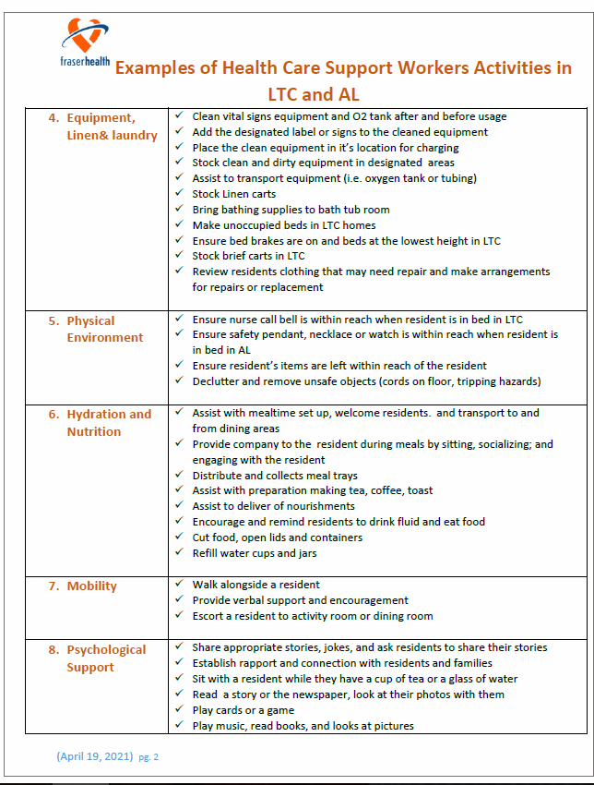
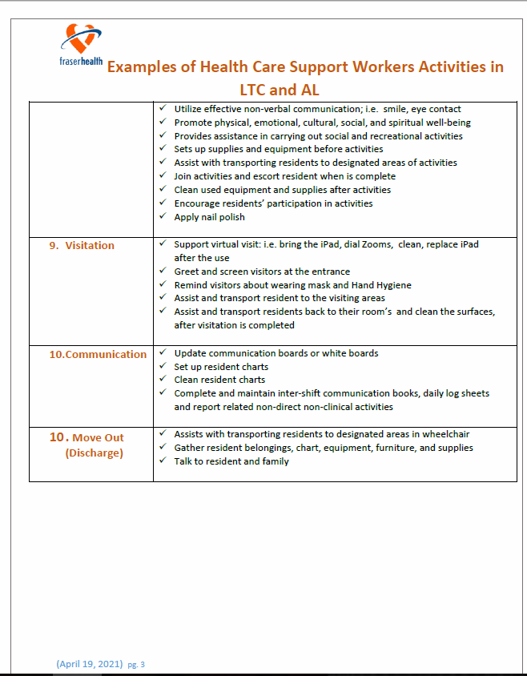
Health Care Support Worker activity examples
Notes:
It is important to go through the individual activities so they fully understand the parameters of their role.

Slide 11
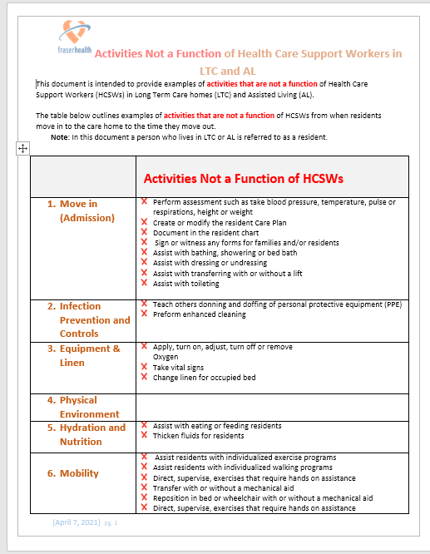
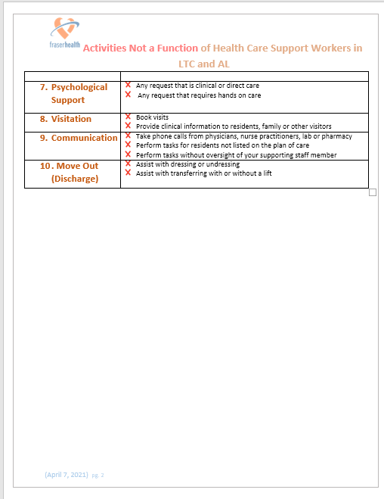
Activities NOT a function of Health Care Support Workers

Slide 12
You will improve the quality of life of residents
By spending one to one time with residents
By helping your team members, you free them up to have more time to provide clinical support to the residents
Notes:
In your role, you will have time to spend 1-1 time with residents that others generally don’t have time to do. You might read to the, help them with a zoom call to a family member or friend, go for a walk, write a letter.

Slide 13
Information about your health care assistant (HCA) schooling
Fraser Health will assign you the school you will attend
Fraser Health or the post secondary institute (PSI) will contact you to confirm when you start school and your schedule
You may work full-time as a health care support worker (HCSW) for several weeks or months before going to school
The training is either full-time or part-time
You remain in your role as a HCSW throughout your schooling
If your schooling is full-time you will work at the facility during your semester breaks
If your schooling is part-time you will go to school 3 days per week and work as a HCSW for 2 days a week, on days that meet operational needs
Although you will be learning new things when you are in school, you can not practice these things as a HCSW until you graduate as a HCA
Notes:
The PSI process is often confusing. So clarifying this is very important. Include the process in your facility for submitting you hours and when they will be

Slide 14
Your pay
You are paid $21.37 as a HCSW
When you are in school you receive a stipend of $801.00 per week.
Your hourly pay include a portion for holiday pay and benefits
You can take 10 days off per year without pay
If you are in school part-time you receive 3/5 of that amount and the other 2 days, you are paid hourly as a health care support workers (HCSW)
Notes:
You will want to clarify how they submit their hours and when they will be paid.

Slide 15
What other questions do you have?
If you still have questions reach out to HCAP@fraserhealth.ca
Notes:
If questions are asked that you don’t have answers to please email HCAP@fraserhealth.ca

