Slide 1
Site Evaluation: Seasonal Readiness (Heat)
[Insert Facility Name]
[Insert Date]
Notes:
Update slide with your site information and the date that you are conducting the evaluation

Slide 2
Agenda
Land acknowledgment
Overview
Introduction
Purpose
Format
Findings
Planning
Preparation
Responding
Evaluation
Closing
Notes:
Run through the agenda

Slide 3
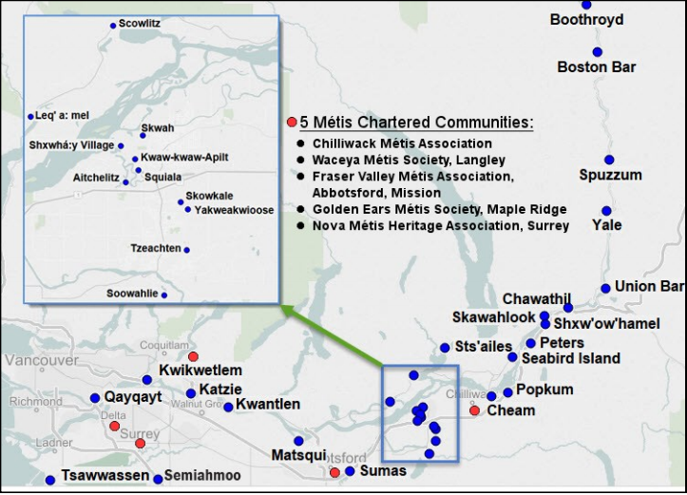
Land acknowledgement
We are meeting today on the traditional, ancestral and unceded territories of the Coast Salish and Nlaka’pamux Nations, which is home to six Métis Chartered Communities. .
Source: www.johomaps.net
Notes:
This section is the overall land acknowledgement for the Fraser region. You may include more detail for your site as needed.

Slide 4
Introduction
A look back at this summer’s heat season to better understand what worked and what can be improved upon next year
Designed to promote free and open exchange of ideas and thoughts
This is an evaluation where lived experiences are explored; we would like to remind everyone of the importance of maintaining a “no-fault” atmosphere
Notes:
Introduction: Thank you for making yourself available today for our focus group to help us understand how we did with regard to our support for this summer’s heat season. My name is xxx and I am your facilitator today. We are holding this session to gather information on the response of our care home to the summer heat season.
Do you have any questions before we begin?
Let’s begin…

Slide 5
Purpose
Explore how we performed with our planning, preparation & response for the summer heat season
Were the standard, escalated and emergency measures implemented?
Were they successful when implemented?
Raise awareness of heat planning and resources
Ensure that residents are cared for through heat events
Evaluate site coordination to a heat event

Slide 6
Format
Key Players (who’s at the table):
Site-based leadership
Key clinical and support staff
Medical staff
Residents and families (ad-hoc)
Methodology:
Small group discussion
Approximately 45 mins
Site-specific events
Response phase
Planning phase
Preparation phase

Slide 7
PLANNING - Developing a heat plan What worked and what can be improved?
Thinking about our heat plan development:
Was our building ready for the summer heat?
Is there clear identification of standard, escalated and emergency measures?
Did we use the resources provided by Fraser Health?
Do we have communication with our residents/families and team members?
Are our high-risk residents clearly identified?
Notes:
Refer to specific events where possible

Slide 8
PREPARATION – Getting ready before a heat event How well did we prepare?
Thinking about our supplies and preparation:
Have we purchased all required supplies?
Have we supported our staff in preparing for summer heat?

Slide 9
RESPONSE – Actions we took during a heat event What worked well? Where are there opportunities?
Thinking about our response(s) to heat this summer:
How did we perform as a site?
Were there heat-related incidents/illnesses? (staff/residents)
Were there issues with cooling any areas?
How did we serve our residents during the heat?
What were some areas to improve on for next year?
Was our written heat plan comprehensive?
Did our team know what to do?

Slide 10
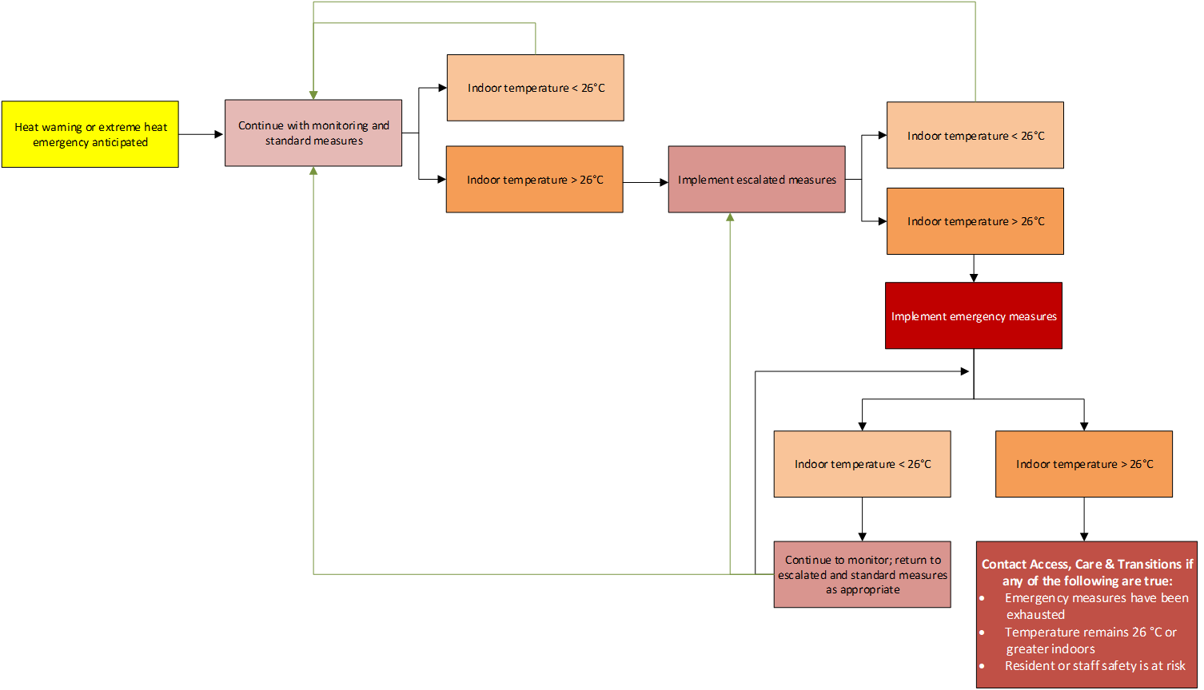
RESPONSE – Actions we took during a heat event Did our escalation process work as it should have?
Notes:
Specifically looking at our escalation process, …

Slide 11
Questions
[Add in any specific site heat events you wish to debrief here]
[Use any of the previous questions to evaluate your response to that specific event]

Slide 12
Closing

Slide 13
Resources
ECAlertMe https://ecalertme.weather.gc.ca/home_en.php
WeatherCAN app https://apps.apple.com/ca/app/weathercan/id1334221563
Alertable https://alertable.ca/#/

